Slide 1
Engaging Society
How to Meaningfully Connect

Slide 2
Engaging Society
How you view God affects how you minister to people
Distant, alone, separate
Close, relational, together

Slide 3
Who is God?
Idea of Who God has developed over time
Early Israel, strict “MonoTheism”
Meaning, One God!
Over time realization of a Triune God
This has Implications!

Slide 4
Who is God?
Implications of One God
Before Creation
Living alone
Implications of Triune God
Before Creation
Living in fellowship

Slide 5
Who is God?
Nature of God
1 John 4:8 “God is Love”
Definition, “Serving other’s and not oneself” (1 Corinthians 13)
Implications!

Slide 6
Who is God?
God philosophically can’t be numerically one, He would have at one point lived for Himself..

Slide 7
Who is God?
Implications
God lives outside of Himself
God has always lived in community
God has always lived in relationship with others, communing, loving, giving, interacting, & conversing.

Slide 8
Who is God?
God is not numerically one but He is relationally one!
Genesis 2:24 / Man & Woman One
John 17:21 / We Become One with Christ

Slide 9
Who is God?
God is Social

Slide 10
Who is God?
God is Relational

Slide 11
The Social God
Exited His world
Entered Our world
Heard our pain
Responded to our situation

Slide 12
Engaging Society
“Especially should those who have tasted the love of Christ develop their social powers, for in this way they may win souls to the Savior” (2MCP 628.2)

Slide 13
Engaging Society
“There are many in this world who communicate, but few who connect” John Maxwell

Slide 14
Finding Common Ground

Slide 15
Finding Common Ground
Finding Uncommon Ground?
Finding Common Ground?

Slide 16
Finding Common Ground
Finding Uncommon Ground?
Weakness
Finding Common Ground?
Strengths

Slide 17
Finding Common Ground
Finding Uncommon Ground?
Weakness
Finding Common Ground?
Strengths

Slide 20
Finding Common Ground
“Agree with the people on every point where you can consistently do so. Let them see that you love their souls, and want to be in harmony with them so far as possible.” (Evangelism p, 141)

Slide 21
Finding Common Ground
Shared Beliefs
Shared Experiences
Common Goals
Similar Backgrounds
Similar Possessions
Mutual Interest
Friend Connections
Shared Hobbies

Slide 22
Finding Common Ground
“Speak to them, as you have opportunity, upon points of doctrine on which you can agree. Give them evidence that you are a Christian, desiring peace, and that you love their souls. Let them see that you are conscientious. Thus you will gain their confidence; and there will be time enough for doctrines.” (GW 119; EV 200)

Slide 23
Finding Common Ground
Which Christian church has more in common with the other churches than almost any other church out there?

Slide 24
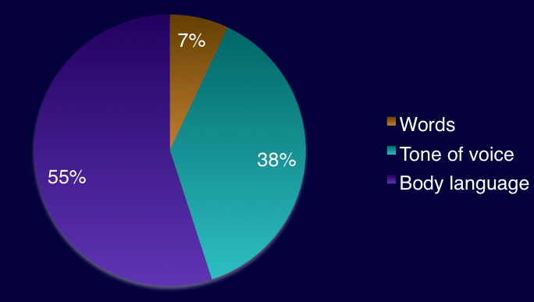
Components of Communication

Slide 25
Components of Communication
Its not just about what you “say”
Its about what you are saying

Slide 26
Listening
E Eyes
A Attention
R Response

Slide 27
Listening
“The greatest gift we can give people is to listen to them” Dietrich Bonhoeffer

Slide 28
Listening
Listen to Understand
Not just to respond
Not to fix them

Slide 29
Listening
“We see things not as they are but as we are” H. M. Tomlinson

Slide 30
Asking Questions
Jesus way!
Questioning the Questioner

Slide 31
Engaging Society
Jesus Way
Matthew 22:15-22 “Whose image and inscription is this?”
Genesis 3:9 “where are you?
Genesis 4:6 “Why are you angry? Why has your countenance fallen?”
1 Kings 19:9 “what are you doing here Elijah?”

Slide 32
Asking Questions
Why?
Because Jesus used Questions
It helps clarify the discussion
It helps you know what they really mean!

Slide 33
Asking Questions
Why?
Gets people to think about their own assumptions
Exposes Contradictions
Indirect & Non-confrontational
Allows them to come to their own conclusion

Slide 34
Asking Questions
How?
Think before you speak!
Pray & Ask HP for guidance
Get to know their questions & their belief system as much as possible

Slide 35
Asking Questions
When?
When you can sense openness
When you can see a their wheels turning
Or to engage them in conversation
Or in a conversation to understand them deeper

Slide 36
Asking Questions
“Engaging with people is not just about having the right answers to their questions, its about having the right questions to their answers”

Slide 37
Open Ended Questions
Close Ended vs Open Ended

Slide 38
Asking Questions
Jesus way!
Questioning the Questioner

Slide 39
Discussion

Slide 40
Engaging Society
“The Don’ts”
Adventist Lingo
“apostate protestantism”
“remnant”
“once I came into the light”
“Spirit of Prophecy”
“Sister White or Ellen White”

Slide 41
Engaging Society
“The Don’ts”
“right arm of gospel”
“true church”
“13th Sabbath”
“crusades”
“General Conference”
“the churches in Babylon”

Slide 42
Engaging Society
“The Don’ts”
Adventist Lingo
There’s a time and place for it!
When you do use them stop and explain!

Slide 43
Why is this important?
“It is a well-known and documented phenomenon that groups... will inevitably adopt an in-house vernacular. This special language performs the following functions”

Slide 44
Why is this important?
It provides a vehicle for the communication of complex concepts within the group
It enhances the feeling of belonging within the group by promoting security for “in”- group members.
It sets apart members of the group from those who are not members — perhaps from those who are not eligible for membership

Slide 45
Review
God is Relational
To Relate we must find Common Ground
Listening
Questioning the Questioner
In House Vernacular

Slide 46
What did you learn?

Slide 48
Atheist & Agnostics
Atheist -
A - “without”
Theist - “God”
Agnostic -
A - “without”
Gnosis - “Knowledge”

Slide 49
Atheist & Agnostics
Atheist = Reject a bad Picture of God
Bad world & Good God?
Theodicy
Agnostics = “you can’t prove it”
Approach question from a modern or a postmodern

Slide 50
Atheist & Agnostics
What doesn’t work
Trying to be smarter than them
Using Scientific Fact to try to disprove them
Guilt them
Put them down

Slide 51
Atheist & Agnostics
What does work!
Affirm their freedom!
Find Common Ground
Affirm what you can
open mindedness
intellectually honest
Seek to understand them

Slide 52
Atheist & Agnostics
What does work!
Seek to understand the WHY
Acknowledge history of the Church...
Acknowledge wrongs done by Religion
Acknowledge evil done in the name of Religion

Slide 53
Atheist & Agnostics
What does work!
“In Christian and Atheist debates I usually find myself agreeing with the Atheist more. They don’t believe the prominent view of God for all the right reasons” (David Asscherick)

Slide 54
Atheist
Why?
Principles of the Kingdom of Satan?

Slide 55
Atheist
Why?
Fear
Control
Manipulation
Shame, Guilt
Pain, hurt, abuse
Self Seeking
Ultimately its about “Me”

Slide 56
Atheist
Why?
Principles of the kingdom of God?

Slide 57
Atheist
Why?
Love
Freedom
Respect
Equality
Mercy & Compassion
Self control & Selfless
Ultimately its about “Others”

Slide 58
Atheist
Why?
Ultimately - Picture of God
Galatians 5:23 “against these there is no law”

Slide 59
Atheist
Video

Slide 60
Atheist & Agnostics
Discussion
Questions?
How do you see this working?

