Slide 1
“Type a quote here.”
–Johnny Appleseed

Slide 2
Inside Out

Slide 3
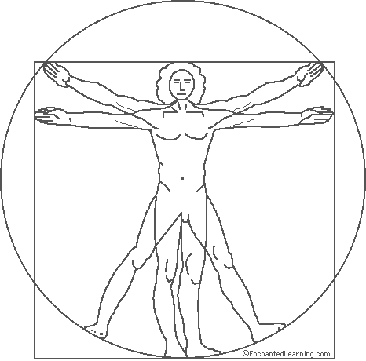
Who is Man?

Slide 4
Who is Man?
Constitutional Nature of Man
Genesis 2:7
Ecclesiastes 12:7 / Job 4:19
James 2:26 1 Corinthians 6:19 1 Thessalonians 5:23 Hebrews 4:12
Matthew 22:37

Slide 5
Who is Man?
Nature of Man
“Through sin the divine likeness was marred, and well-nigh obliterated. Man’s physical powers were weakened, his mental capacity was lessened, his spiritual vision dimmed. He had become subject to death” (Education, pg. 15-16)

Slide 6
Who is Man? Nature of Man
“To restore in man the image of his Maker, to bring him back to the perfection which he was created, to promote the development of body, mind, and soul, that the divine purpose in his creation might be realized — this was to be the work of redemption. This is the object of education, the great object of life”

Slide 8
Nature of Man
Physical | Body | Health System
Mental | Mind | Education System
Spiritual | Spirit | Local Churches

Slide 9
Nature of Man
Health System
Education System
Local Churches
Adventism

Slide 10
Walla Walla University Seal

Slide 11
Anthropological Monism vs Dualism

Slide 12
Monism Mono
Greek definition: “alone” “single” “one”
Example
Mono-theism: Belief in One God Mono-poly: One company dominating market Mono-gamy: Being married to One person

Slide 13
Nature of Man
“Monism insists that humans are not to be thought of as in any sense composed of parts or separate entities, but rather a radical unity” (Christian Theology pg. 543)

Slide 14
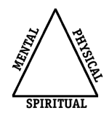
Nature of Man
Human Being

Slide 15
How does restoration take place?

Slide 17
Transformation
“I therefore urge you, brothers, in view of God’s mercy, to offer your bodies as living sacrifices that are holy and pleasing to God, for this is the reasonable way for you to worship.”
And do not be conformed to the pattern of this world, but be transformed by the renewing of your mind, that you may be able to test and approve what God’s will is —His good, pleasing and perfect will.” (Romans 12:1-2)

Slide 18
Transformation
Does what you believe affect you?
Vance Vanders - Cemetery
Sam Shoeman - Metastatic Liver Cancer Derek Adams - Overdosed on Medication

Slide 19
Transformation
“Conformed” Grk (suschematizo)
Literally means to be molded or stamped according to a pattern.
“Don’t let the world around you squeeze you into its own mold.”

Slide 20
Transformation
“Transformed” Grk (metamorphoo) “metamorphosis.” When a tadpole is changed into a frog or when a caterpillar becomes a butterfly, we speak of it as a metamorphosis.

Slide 21
Transformed
Metamorphoo (4 Occurrences in NT) 1. 2 Corinthians 3:18 2. Matthew 17:2/ Mark 9:2 “and He was transfigured before them”

Slide 22
Transformed
2 Corinthians 4:16
Imprisoned Golf Player

Slide 23
Inside Out
Mark 2:3-12 Story of the Paralytic

Slide 24
Inside Out
“…the Hebrew writers had recognized the essential unity of body, mind, and spirit and had stressed the relative dependance of one upon the other. When Jesus approached this man as one who's whose primary need was for the assurance of forgiveness, he was reflecting the Jewish thinking of his day that sin and health are related, but in a larger sense he was demonstrating a recognition of the relationship which exists between attitudes of the mind and health of the body”
(William Barclay in The Gospel of Mark, pg. 40)

Slide 25
Inside Out
“Physicians have discovered that guilt, like anxiety, may serve to inhibit or paralyze the functions of the body or mind”
(Psychiatry and the Bible, pg 60)

Slide 26
Inside Out
“The boy was approached not in terms of his paralyzed legs but on the level of his spiritual problems… Torn apart by a sense of sin, perhaps precipitated by adolescent feelings of guilt, this young man needed Jesus’ reassurance of God’s forgiveness of his sins.”
(Jesus & Logotherapy, pg. 59)

Slide 27
Transformation?
And do not be conformed to the pattern of this world, but be transformed by the renewing of your mind, that you may be able to test and approve what God’s will is —His good, pleasing and perfect will.” (Romans 12:1-2)

Slide 28
Why?

Slide 29
How God works in me?
How I witness-relate to Others?

Slide 30
Christ Method
1. Mingled 2. Sympathized 3. Ministered 4. Won Confidence 5. Follow Me

Slide 31
Inside Out

